Slide 1
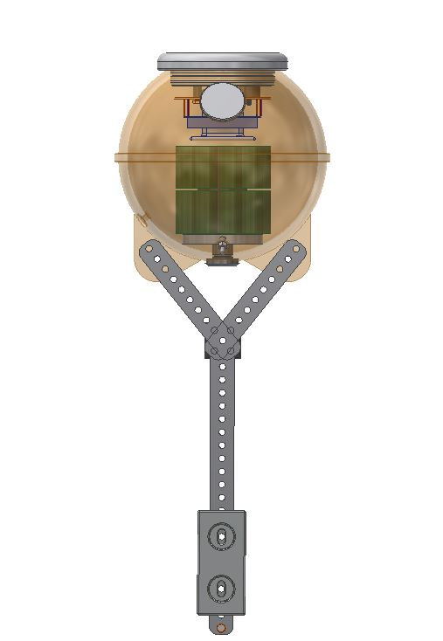
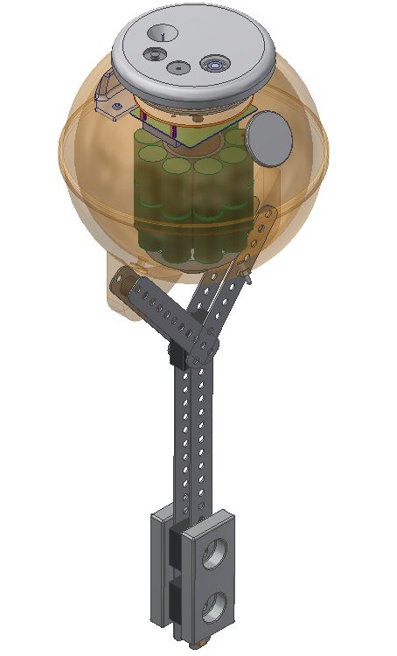
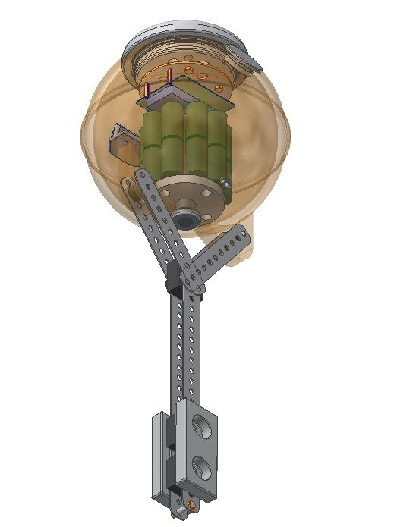
Fast Response Temperature Probe Topside Temperature Probe (TTP)
Endcap
Vacuum Port
Skye Instruments PAR
Keller Pressure Sensor
UCAM III Low-Resolution Digital Camera
UCAM III Low-Resolution Digital Camera
30.5 cm (12inch)
diameter side-lug t-float
Slow Response Temperature Probe
Sea Surface Temperature (SST)
Turner Cyclops 7F Fluorometer
Frame
Counterbalance

